Slide 1
Kiva.org loan delays
capsTONE PROJECT I

Slide 2

Problem statement
Kiva
Non-profit organization that allows people to lend money via the Internet to low-income entrepreneurs and students in over 80 countries. Kiva's mission is "to connect people through lending to alleviate poverty."
Goal of the project
Understand what variables cause a higher delay between the time a loan is funded and the time a loan is posted or pre-disbursed to low-income entrepeneurs.

Slide 3
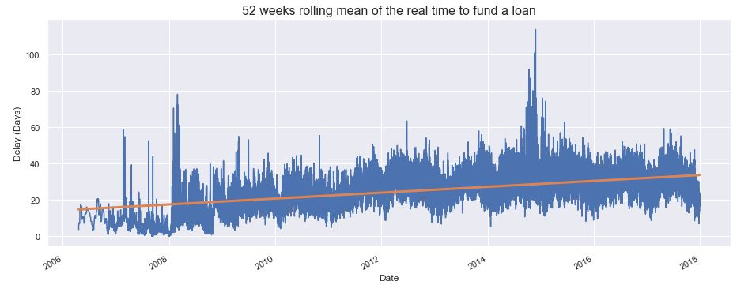
EXPLORATORY DATA ANALYSIS
Delays are increasing, on average, over time
“Real” time delay:
Difference (in days) between the time of the funding of a loan and the posting on Kiva’s website or the time of pre-disbursal to the client, whichever occurred first.

Slide 4
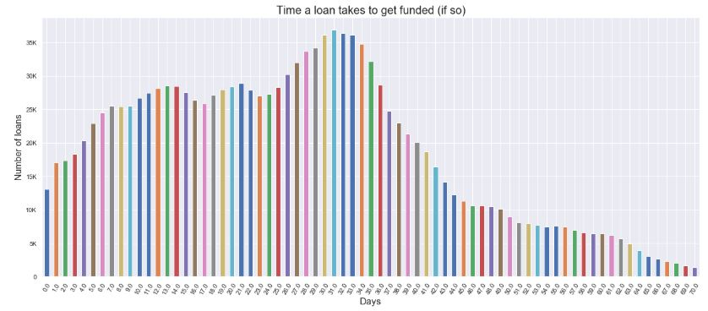
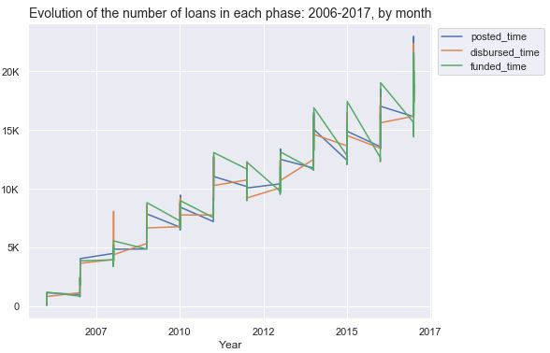
EXPLORATORY DATA ANALYSIS
Close to 60% of loans are funded within a month | 97% are funded within 2 months.
THE CYCLICAL NATURE OF THE KIVA LOAN

Slide 5
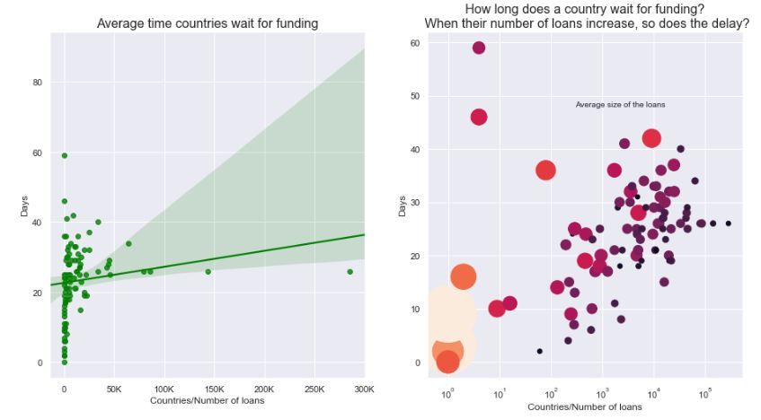
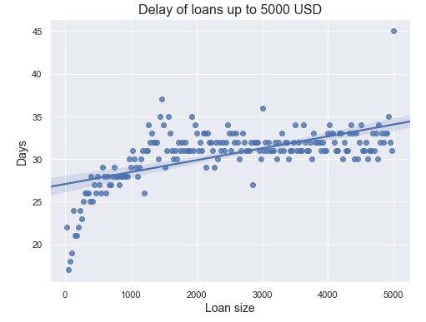
EXPLORATORY DATA ANALYSIS
COUNTRIES
LOAN AMOUNT
SOME IMPORTANT FEATURES

Slide 6
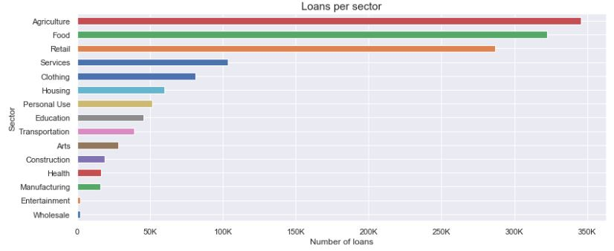
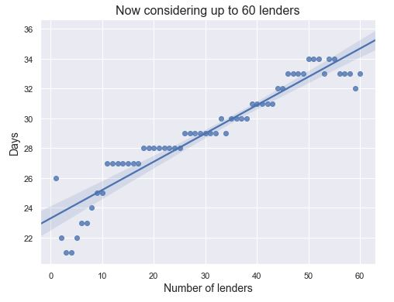
EXPLORATORY DATA ANALYSIS
SECTORS
TOTAL NUMBER OF LENDERS
SOME IMPORTANT FEATURES

Slide 7
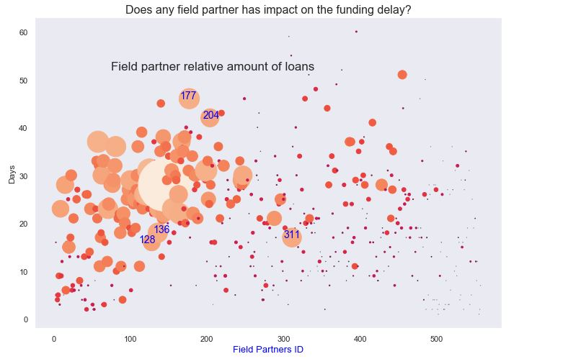
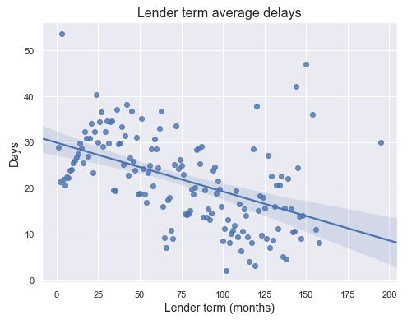
EXPLORATORY DATA ANALYSIS
PARTNERS
LENDER TERM
SOME IMPORTANT FEATURES

Slide 8
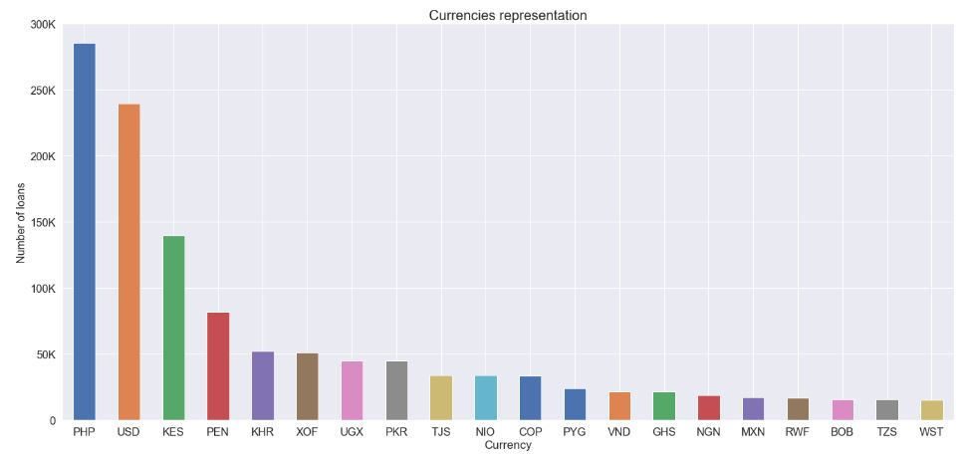
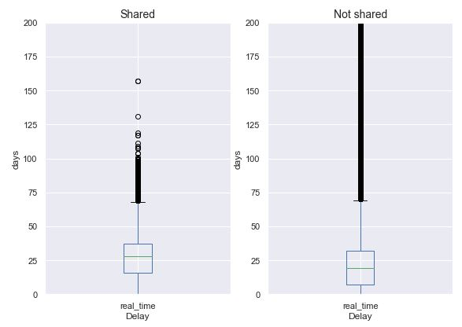
EXPLORATORY DATA ANALYSIS
CURRENCIES
CURRENCY POLICY
SOME IMPORTANT FEATURES

Slide 9
MODEL and Initial Feature EXTRACTION:
Model:
Classification problem | "high" vs "low" delay:
"high" loan delay: a loan that takes > 26 days to fund: 1
“low" loan delay: a loan that takes <= 26 days to fund: 0
Countries: Main 50 countries (97% of the data) ---> remaining countries into 'country_name_other'.
Partners: Main 100 partners (85% of the data) ---> remaining partners into 'partner_id_other’.
Currency: Main 25 currencies (90% of the data) ---> remaining currencies into 'currency_other’.

Slide 10
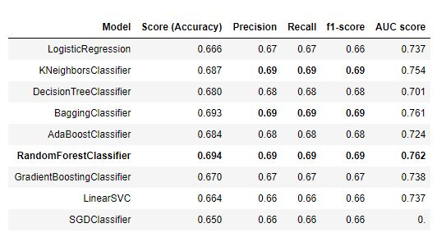
Model results & Tuning
MODEL RESULTS
TUNING RANDOM FOREST CLASSIFIER
{
'criterion': ['gini', 'entropy'],
'min_samples_leaf': [1, 2, 3, 4, 5, 10, 20],
'max_features': ['auto', 'log2’],
'max_depth': [None, 4],
'min_samples_split’: [2, 3],
'n_estimators' [10, 100, 200, 400]
}

Slide 11
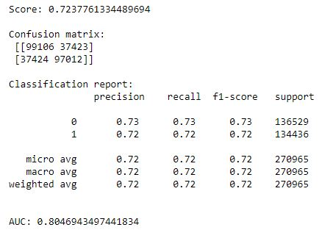
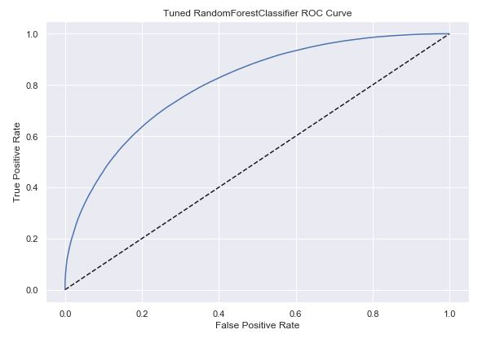
WINNER: RANDOM FOREST CLASSIFIER
RandomForestClassifier(‘min_samples_leaf’=4, n_estimators=400, random_state=SEED)

Slide 12
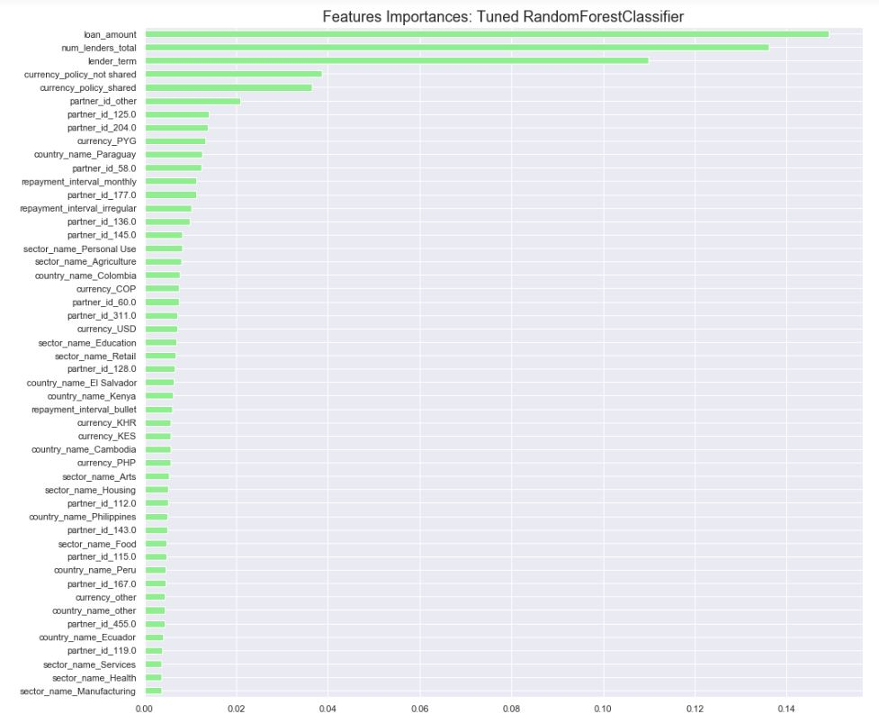
Feature importances 1. Loan amount 2. total number of lenders 3. lender term 4. currency policy (shared or not) 6. other partners (300+) 7. …

Slide 13
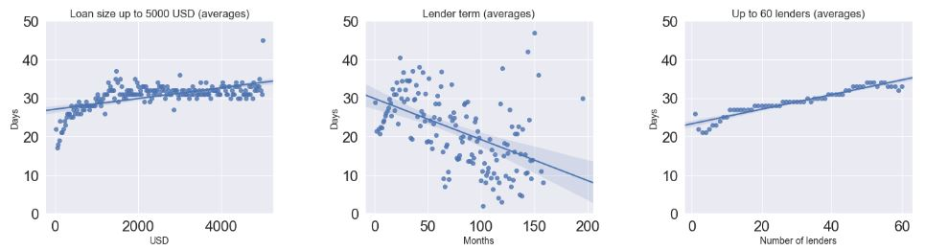
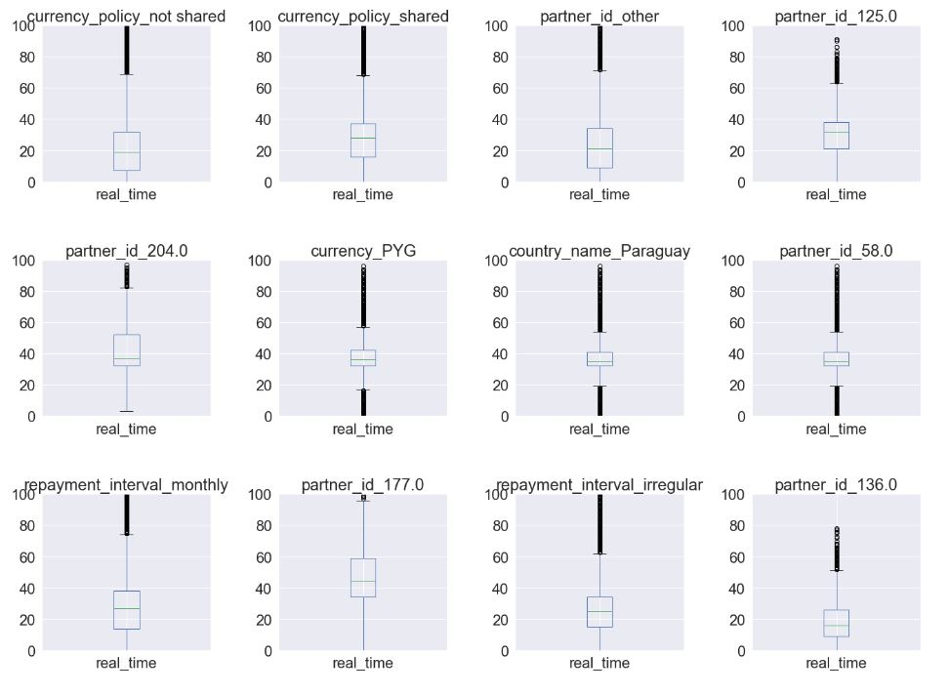
Feature importances 15 MOST IMPORTANT 63 % CUMULATIVE IMPORTANCE

Slide 14
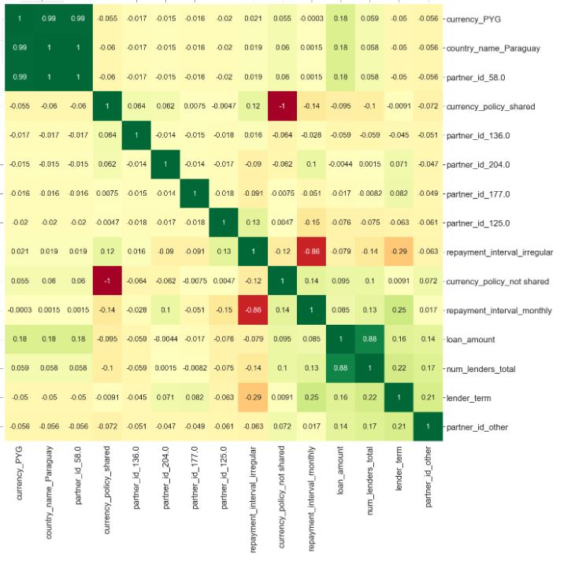
Caution with the interpretation These importances might hide the fact that a cause of a delay in a loan can have origin on one or few variables, but when other variables are highly correlated with those, they will appear "important" as well. EXAMPLE: Guarani, PARAGUAY’S currency. SHARP devaluation of the Guarani during THIS PERIOD. the USD/PYG exchanged at 3972.000 in 2008, and by 2018 that rate was 5697.113. ➔ CURRENCY POLICY contributed significantly to delays, which points to the fact that strong devaluations are difficult to deal with, specially after the 20% mark

